Slide 1

LABORATORY SERVICES MANAGEMENT
A 3-Month Certified Course – 12 Career-Boosting Modules

Slide 2
Why Should You Join This Course?
✔ Learn end-to-end management of hospital laboratories
✔ Understand quality control, NABL/NABH audits, safety, and customer service
✔ Ideal for lab managers, technicians, QA officers, and healthcare staff
🎓 Certification included | No prior lab experience required
📈 Aligns with global standards in diagnostics and clinical excellence

Slide 3

Course Highlights
📘 12 CAREER-BOOSTING MODULES
📝 PRACTICAL ASSIGNMENTS
📅 DURATION: 3 MONTHS
🎓 CERTIFICATION ON COMPLETION

Slide 4

📌 Course Highlights:
🧪 Lab Design | 🛡️ Safety Protocols
🟩 Module 1 – Laboratory Organisation & Design
Basics of lab layout, functional zones, and workflow design.
🟨 Module 2 – Facilities and Safety
Set up proper safety protocols, lab signage, and biosafety zones.
🟧 Module 3 – Health Laboratory Management & Effective Communication in the Laboratory
Lab coordination, staff roles, communication systems, and report flow.
🟥 Module 4 – Laboratory Policies
Policy creation, implementation, and internal lab documentation.

Slide 5
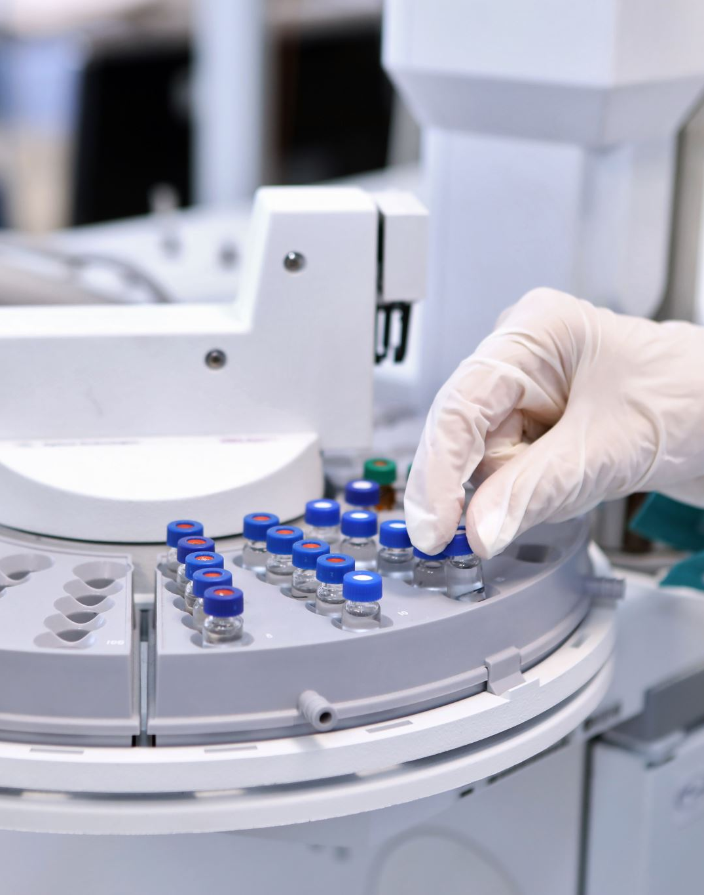
Course Highlights
🟦 Module 5 – Equipment
Types of lab equipment, maintenance logs, and calibration.
🟩 Module 6 – Purchasing and Inventory
Tracking materials and reagents using inventory systems and reorder levels.
🟧 Module 7 – Process Control: Sample Management & Intro to Quality Control
Procedures for receiving, labeling, transporting, and controlling samples.
🟨 Module 8 – Process Control: QC for Quantitative, Qualitative & Semi-Quantitative Tests
Establishing QC for different test types with SOPs.

Slide 6
Course Highlights
🟥 Module 9 – Assessment: Audits and External Quality Assessment
Prepare for internal & external audits including EQAS.
🟩 Module 10 – Assessment: Norms, Accreditation, Documents, and Records
Documentation & records for NABL, NABH, ISO, and internal review.
🟦 Module 11 – Customer Service, Occurrence Management & Process Improvement
Managing customer feedback, complaint logs, and quality improvement projects.
🟧 Module 12 – Information Management and Organization
IT systems, LIS (Laboratory Information Systems), and result management.

Slide 7
Want to Excel in Lab Management & Quality Standards?
🌍 Suitable for lab managers, diagnostic staff, QA teams & healthcare students
📧 Contact: qtopglobalservices@gmail.com
🌐 To avail the course, visit: www.qtopglobal.com

