Slide 1

HOSPITAL MAINTENANCE DEPARTMENT MANAGEMENT
A 3-Month Certified Course – 12 Career-Boosting Modules

Slide 2
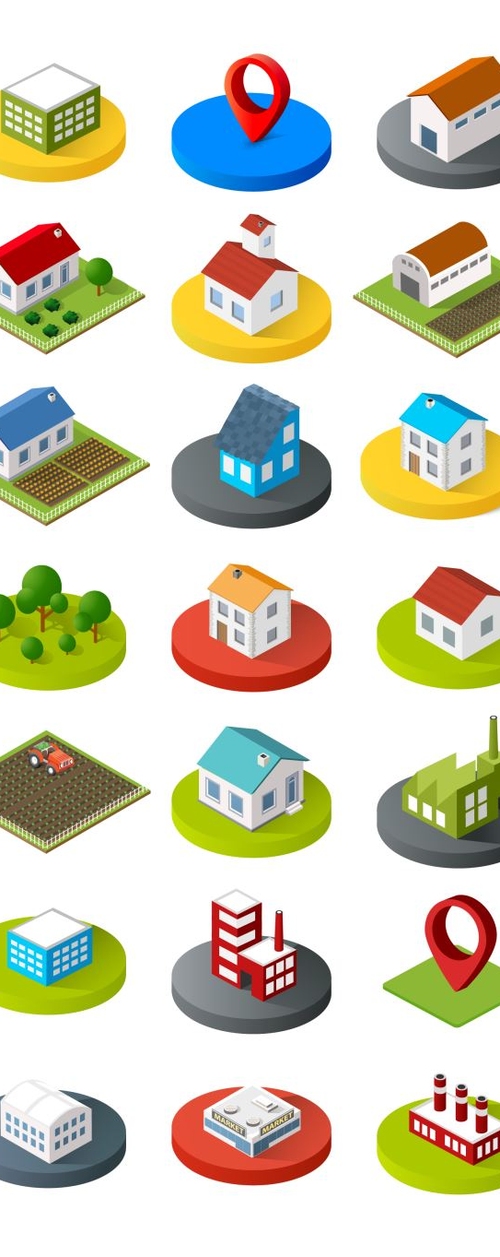
Why Should You Join This Course?
✔ Master hospital infrastructure safety, cleanliness, and sustainability
✔ Learn SOPs, civil/plumbing systems, biomedical waste and STP maintenance
✔ Ideal for hospital supervisors, facilities managers, housekeeping leads
🎓 Certification included | Required in NABH & ISO facility management roles
📈 Vital for maintaining hospital functionality, hygiene, and compliance

Slide 3

Course Highlights
📘 12 CAREER-BOOSTING MODULES
📝 PRACTICAL ASSIGNMENTS
📅 DURATION: 3 MONTHS
🎓 CERTIFICATION ON COMPLETION

Slide 4
📌 Course Highlights:
🧼 Housekeeping | 🧭 SOPs | 🏷️ Risk Categorization
🟩 Module 1 – Hospital Maintenance Department Management: Introduction
Roles, responsibilities, and functions of the maintenance department.
🟨 Module 2 – General Maintenance – Housekeeping
Daily maintenance tasks and schedule-based cleanliness protocols.
🟧 Module 3 – Risk Categorization of Hospital Areas
Classify zones based on risk and service frequency (e.g. OT vs public toilets).
🟥 Module 4 – Standard Operating Procedures for Cleaning
SOP creation for surface cleaning, isolation rooms, and public spaces

Slide 5
📌 Course Highlights:
🧪 Biomedical Waste | 🛠️ Civil | 💧 Water Safety
🟦 Module 5 – Biomedical Waste Management, Pest Control & Cleaning Assessment
Manage waste flow, pest elimination, and verify cleanliness standards.
🟩 Module 6 – Civil Maintenance
Address civil issues like flooring, walls, masonry, plumbing leakage.
🟧 Module 7 – Plumbing System
Water supply lines, drainage layout, and plumbing maintenance cycles.
🟨 Module 8 – Water Hygiene in Healthcare Facilities
Ensure safe drinking water and disinfection of storage tanks

Slide 6
📌 Course Highlights:
🧽 Sanitation | ♻️ Green Planning | 🧯 STP Systems
🟥 Module 9 – Sanitation and Hygiene
Ensuring clean washrooms, drainage, and public areas meet NABH norms.
🟩 Module 10 – Environment Management Plan for Hospitals
Creating eco-friendly operations and reducing facility waste.
🟦 Module 11 – Hospital Wastewater Treatment System
Introduction to ETP/STP functioning and monitoring.
🟧 Module 12 – Hospital Sewage Treatment System
Maintenance of hospital STPs and compliance with local pollution control boards.

Slide 7
Become a Hospital Maintenance Management Expert!
🌍 Ideal for facility managers, operations staff & housekeeping supervisors
📧 Contact: qtopglobalservices@gmail.com
🌐 To avail the course, visit: www.qtopglobal.com

