Slide 1

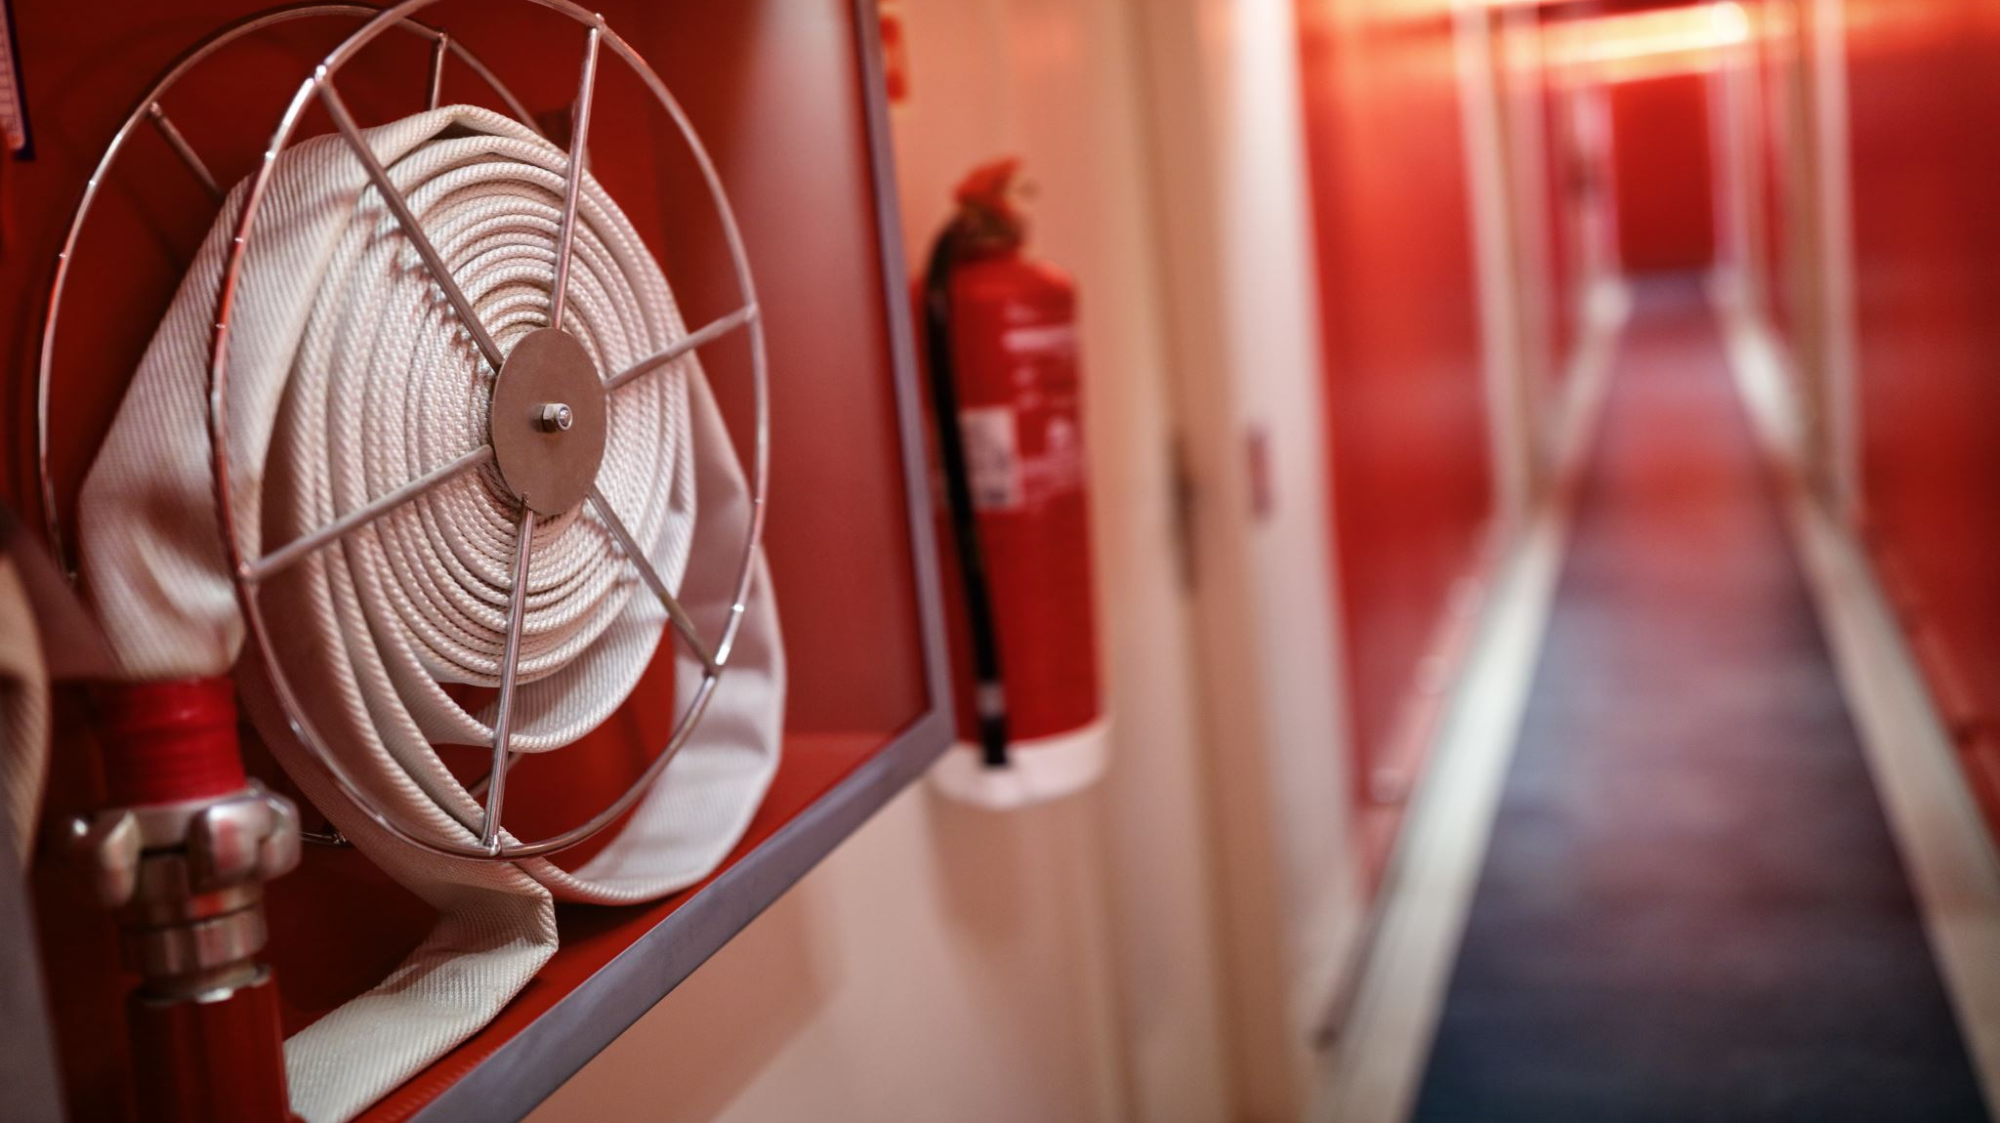
FIRE SAFETY DEPARTMENT MANAGEMENT
A 3-Month Certified Course – 12 Career-Boosting Modules

Slide 2

Why Should You Join This Course?
✔ Learn how to design, implement, and audit hospital fire safety systems
✔ Understand fire risk assessment, firefighting SOPs, and legal standards
✔ Ideal for hospital safety officers, maintenance heads & accreditation teams
🎓 Certification included | Aligned with NABH fire safety compliance
📈 Crucial for patient safety, structural safety, and emergency preparedness

Slide 3

Course Highlights
📘 12 CAREER-BOOSTING MODULES
📝 PRACTICAL ASSIGNMENTS
📅 DURATION: 3 MONTHS
🎓 CERTIFICATION ON COMPLETION

Slide 4

📌 Course Highlights:
🔥 Risk Assessment | 📋 Policies | 🛡️ Awareness & SOPs
🟩 Module 1 – Fire Safety Foundations & Awareness Generation for Hospital Safety
Building awareness of fire risks, responsibilities, and emergency behavior.
🟨 Module 2 – Safety Policy
Creation, approval, and enforcement of fire and emergency policies.
🟧 Module 3 – Organising for Safety
Establishing fire safety teams, communication, drills, and task delegation.
🟥 Module 4 – Principles of Fire Risk Assessment
Evaluate hazards, assign risk scores, and prioritize prevention plans

Slide 5
📌 Course Highlights:
💥 Fire & Explosion | 🏥 Hospital Design | 🚪 Evacuation
🟦 Module 5 – Principles of Fire and Explosion
Understand types of fire, causes, and behavior of fire in confined spaces.
🟩 Module 6 – General Principles of Control, Causes & Prevention of Fire
Eliminate fire triggers and design preventive infrastructure.
🟧 Module 7 – Design and Safety of Hospital Buildings
Safe construction layouts, exits, firefighting access, and ventilation.
🟨 Module 8 – Fire Safety in Hospitals & Safety of People in the Event of a Fire
Evacuation plans, vulnerable patient handling, and alarm systems.

Slide 6
📌 Course Highlights:
📊 Audit & Review | 🧯 Fire Reporting | ✅ Legal Readiness
🟥 Module 9 – Monitoring, Auditing & Reviewing Fire Safety Systems
Conduct fire drills, evaluate equipment, review logs and inspection records.
🟩 Module 10 – Reactive Monitoring – Reporting, Recording & Investigation
Respond to fire incidents, analyze root causes, and document findings.
🟦 Module 11 – Environmental Impact of Fire
Air pollution, water contamination, and toxic material release post-fire.
🟧 Module 12 – Licensing, Accreditation & National Action Framework for Hospital Safety
Understand legal frameworks, NABH/NBC guidelines, and documentation.

Slide 7

📢 Become a Certified Hospital Fire Safety Officer!
🌍 Ideal for fire marshals, safety officers, hospital managers, and auditors
📧 Contact: qtopglobalservices@gmail.com
🌐 To avail the course, visit: www.qtopglobal.com

